Slide 1


Apeiron
Engineering Excellence With Uncompromising Safety
Pioneering the future of engineering through digital transformation, grounded in culture of safety and resilience.
www.apeironengg.com

Slide 2
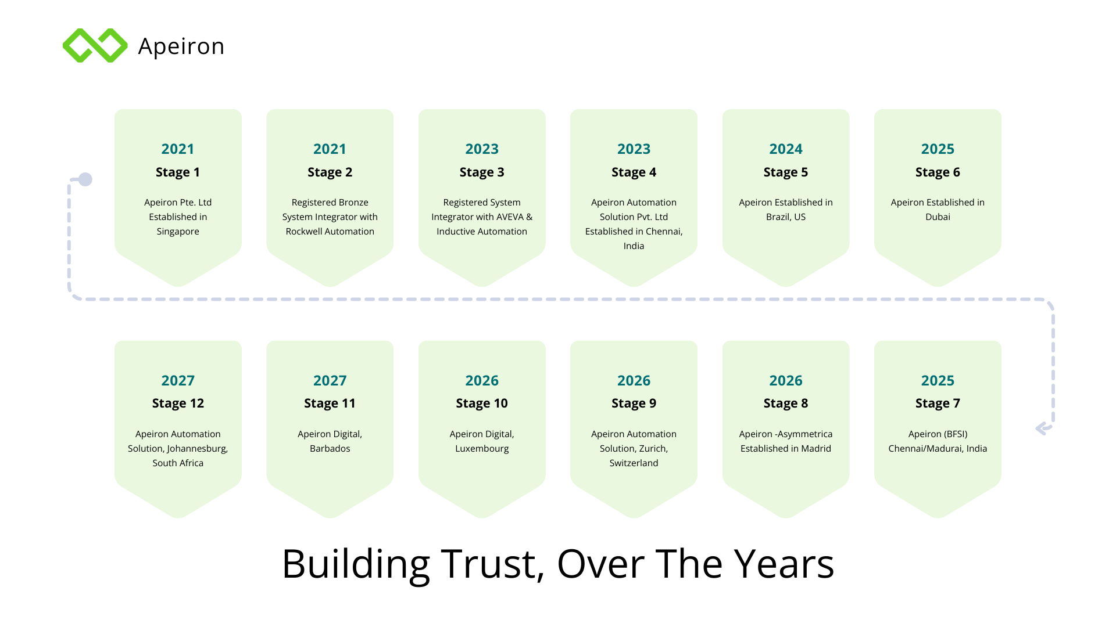

Slide 3



Apeiron
International Footprint
Spain
Iraq
Oregon, USA
Oman
UAE
Guyana
India
Singapore
Vitoria, Brazil
Global Capability Summary
Active across 9 countries​
Enabling global project execution​
Local support and compliance​

Slide 4
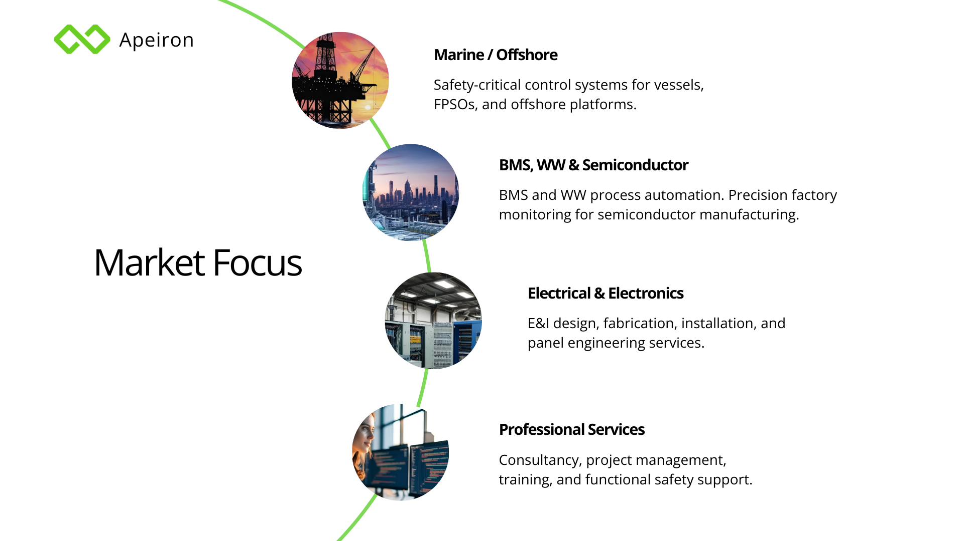

Slide 5





Apeiron
Solutions & Services
OT/ICS​
CYBERSECURITY​
FUNCTIONAL​
SAFETY​
ELECTRICAL &​
INSTRUMENTATION​
CONTROL​ SYSTEM​
INTEGRATION​
ADVANCED SOLUTIONS &​ CONSULTANCY​
OT Network & Cybersecurity
Functional Safety Management​
Project Management Consultancy​
Critical PCS/Basic PCS Consultancy​
FEED Design, Fabrication & Installation​
Turnkey E&I Integration​
SCADA Solutions​
PLC / DCS / HMI Programming​
Turbomachinery & Compressor Controls​
Training & Upskilling​
Manufacturing Execution System (MES)​
IoT Solution​
Downtime & OEE Analysis​
Factory Monitoring & Control​
Recipe Management
Batching System
Statistical Process Control​
Inventory Management​
Traceability Solution​

Slide 6


Apeiron
Cybersecurity Awareness Sessions
Advanced OT Cybersecurity Training
Fundamentals of Functional Safety
Training Services
Risk Assessment & Alarm Management
Workforce Competency Development
Strategic Partnership With DNV
Apeiron provides certified training in partnership with DNV for Functional safety & Cybersecurity.​

Slide 7
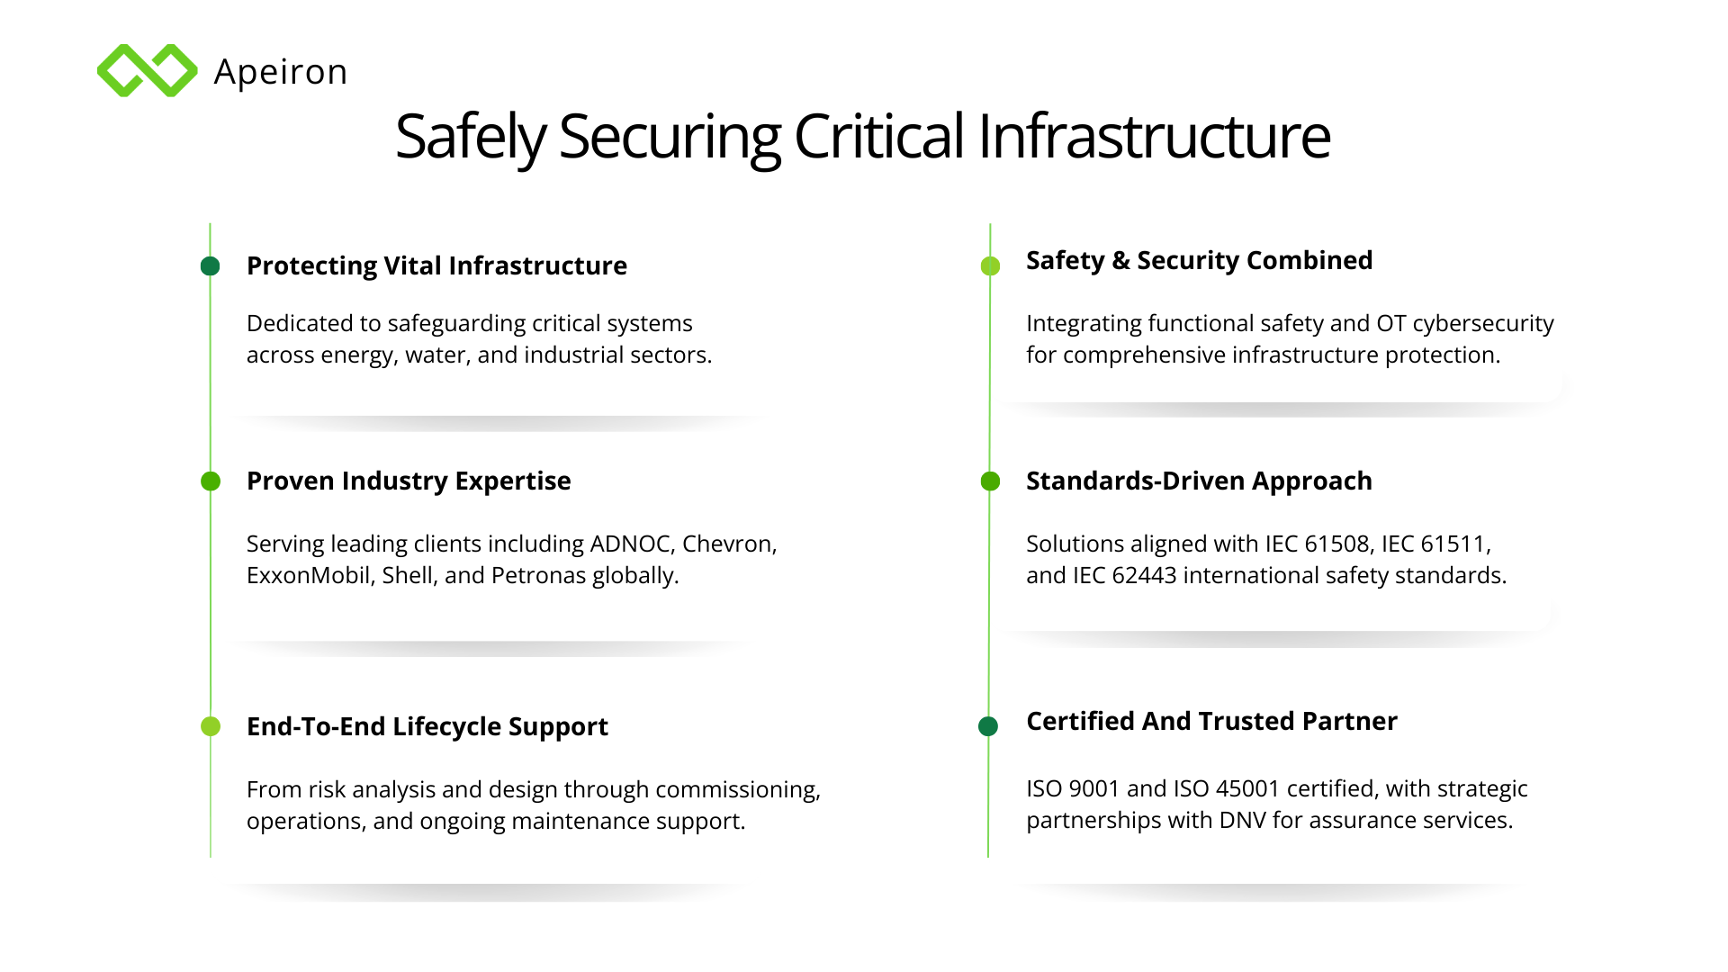

Slide 8













Apeiron
Functional Safety
To safeguard against hazards resulting from faulty and interrupted functionality
|
|
Full Safety Lifecycle​
Coverage​
Risk Analysis & Protection​
Layer Design​
Integrated advisory services​
spanning risk analysis, protection​
design, system validation, and ongoing​
operational support.​
Perform Quantitative Risk​
Analysis (QRA) to assess Major​
Accident Hazards (MAH) and design robust​ protection layers.​
|
Second Party Advisory​
& Verification Services
Integrated​
Safety & Security​
|
Operations and Maintenance​ Support​
Allocation of Safety​
& Security Functions​
Deliver operator training on​
functional safety and support close-​
out of independent Functional Safety​
Assessment (FSA) recommendations.​
Provide training on Risk Graph and​
LOPA; review SIF architecture to​
identify common cause failures.​
|
|
Installation, Commissioning & Validation
Design & Engineering of the Safety Instrumented System
Advise on Site Acceptance Testing (SAT)​
procedures and conduct walk-throughs of​ proof test procedures.
Review vendor competency, SRS​
documents, and SIL certificates for​
compliance with IEC 61508​ and IEC 61511.​

Slide 9







Apeiron
Services - Functional Safety
SIL VERIFICATION​
HAZOP & LOPA​
SIL ALLOCATION​
Rigorous SIL verification using​
exSILentia tool, ensuring compliance​
with IEC 61508 and IEC 61511​
standards.​
Structured hazard identification and​
Layer of Protection Analysis to quantify​
risk and define safety requirements.​
Systematic allocation of Safety​
Integrity Levels to Safety Instrumented​
Functions based on risk assessment​
outcomes.​
LIFECYCLE MANAGEMENT​
ASSESSMENTS & TRAINING
DNV PARTNERSHIP​
End-to-end safety lifecycle support​
from concept through decommissioning,​
aligned with IEC 61511 requirements.​
Independent Functional Safety​
Assessments and certified training​
delivered by TUV and exida qualified​
engineers.​
Strategic alliance with DNV enables​
SIL product certification and advanced​
functional safety consultancy services.​
Apeiron has strategic partnerships, including a key alliance with DNV, for advanced Functional Safety & Cybersecurity.​
Certified experts including CFSE (expert), exida IEC 61511 & TUV engineers​

Slide 10






Apeiron
Functional Safety Consulting Engagements
Chevron & JPTT PLC Projects (2022–2023)​
Trusted System Migrations & Upgrades (2009–2020)​
BMS/BCS Logic & HMI Support (2019–2023)​
01
Software migration, FAT, preventive maintenance, and​ site inspection for Chevron SRU Incinerator and JPTT​ ControlLogix systems.​
02
Lead Engineer for SRC RCC ESD PLC upgrades and​
Indonesia Balikpapan Regent Safety System processor​
migration across multiple phases.​
03
Logic modification and HMI support for Suralaya and​
Melaka 2,242MW CCPP BMS using AAdvance system​
and FTView.​
Jhal Magsi Gas Field ICSS (2012)​
SIS & ESD Engineering Lead (2021–2022)​
Trusted System Maintenance (2022)​
04
Lead Engineer for ESD and PCS using AAdvance system,​
covering full ICSS scope for the Jhal Magsi Gas Field​
project.​
05
Led design and documentation for FPSO SIS P78 and​
Seawater Treatment Package Sangonar using​
ControlLogix systems.​
06
Preventive maintenance, hardware changes, and​
maintenance support for Vietnam PVEP, Singapore Tuas​
Power, and Sembcorp sites.​

Slide 11
Apeiron
Functional Safety Consulting Engagements
Bangladesh Sangu & Alpha Platform Upgrade (2010–2011)
SRC ESD System CPU Upgrade (2011)
Indonesia Jabung Gas Booster SDS Commissioning (2009)
07
Upgrade of Regent system to Trusted power, logic modification, and site hardware service for Bangladesh Sangu Onshore and Alpha Platform.
08
Engineering and commissioning for SRC ESD system CPU processor upgrade, including developing logic solver and panel integration for ESD application and providing site service.
09
Commissioning of SDS system including logic solver editing and panel wiring troubleshooting for Indonesia Jabung Gas Booster Station.
PT Badak NGL Train H HMI Upgrade (2009)
Capital Tower GIC FCU HMI Development (2000–2001)
Changi Naval Base FCC HMI Development (2001)
10
Modification and commissioning works including Human Machine Interface upgrade for PT Badak NGL Train H.
11
HMI development for FCU system at Capital Tower GIC using Siemens WinCC platform.
12
HMI development for FCC system at Changi Naval Base Frequency Converting Station using Intellution Fix32.
Vietnam & Singapore ESD/FGS Enhancements (2004–2010)
Kuwait Oil Company FGS Upgrade (2007–2009)
13
ESD/FGS HMI and logic solver modification using Siemens TD17, Intellution iFix, Trusted, and Rockwell FactoryTalk; including SCADA and report development.
14
Engineering, commissioning, and upgrading jobs including developing logic solver, Human Machine Interface, and panel integration for FGS application.

Slide 12

Apeiron
Functional Safety Consulting Engagements
TRICONEX SAFETY CONTROLLERS (2011-2017)
SIEMENS SAFETY CONTROLLERS (2004-2011)​
Reliance Industries, India: ITCC System for 14 gas compressor​ trains using Tricon & TriGP.​
Multiple LNG Ships (2004-2011): Boiler Control, BMS, & HD/LD Gas​ Compressor Control.​
Ethydcо (Egypt): 3 ITCC compressor systems.​
VSP RP3 FGS (Siemens-Protocols) 2005​ Operator panel HMI development.​
PT Petrokimia Gresik (Indonesia): 4 ITCC compressor systems.​
VSP BK9 FGS (Intellution-Fix32) 2003​ HMI development FGS system.​
Sembcorp Cogen, Singapore - Fire Alarm (FAS).​
ExxonMobil, Singapore - SHDS (ESD).​

Slide 13
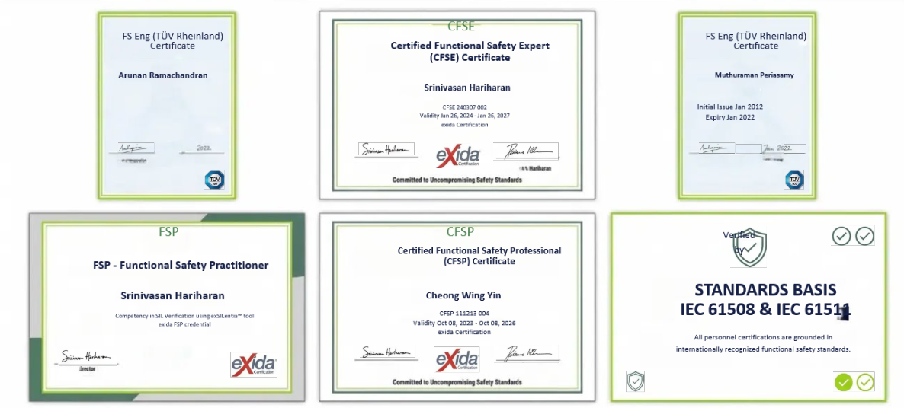
Apeiron
Team Certifications
Committed to Uncompromising Safety Standards​

Slide 14

Apeiron
Metering System Liquid & Gas
Project References
Sembcorp Cogen, Singapore
FAT & SAT​
Sembgas, Singapore
Power Gas, Singapore
System Validation
Engineering References
Air Liquide, Singapore
Meter to Meter Verification
Linde, Singapore
BW Offshore Adolo FPSO, Singapore
Preventive Maintenance
Modec TEN FPSO, Singapore
Proving
PTTEP Yadana Platform, Myanmar
PVGas, Vietnam​
Chevron, Bangladesh​
Perisai Kamelia FPSO, Malaysia

Slide 15

Apeiron
Design, Fabrication & Installation
End-to-end E&I solutions from engineering design through physical fabrication​ and on-site installation.
Engineering Design Review & Consultancy
Expert review of electrical and instrumentation designs with professional​
consultancy support.
Electrical & Instrumentation
Start-Up & Turnkey Field Services
Comprehensive turnkey field services including system start-up, commissioning,​ and handover support.
Plant Maintenance Support
Ongoing maintenance services to ensure reliable and safe plant operations and​ system uptime.
Electrical & Mechanical Components Procurement Services
Sourcing and procurement of quality electrical and mechanical components for​ industrial projects.

Slide 16

Apeiron
Control System Platforms
ALLEN BRADLEY
SIEMENS
GENERAL ELECTRIC
SLC 5/04, 5/05, Compact Logix, Control Logix, Micro Logix, Trusted, AADVANCE
S7-1200, S7-1500, S7-400 and Safety Manager PLC
GE RX7I, 90-30, 90-70
Point I/O, Flex I/O, Control Net, Ethernet, factory Talk Suite SCADA
Profibus, Profinet, MPI, ET200
WinCC and Cipmplicity HMI
Proficy ME
HONEYWELL
SCADA
OMRON
Experion DCS with C300 controller
Wonderware
Ignition
CJ, CP, NJ
Experion SCADA
Wonderware Factory Talk Suite
Win CC Experion SCADA
Ethernet, ProfiNet
Apeiron supports cross-platform migration opportunities across all listed manufacturers, ensuring minimal downtime and seamless transitions.
End-to-end expertise spanning PLCs, DCS, safety controllers, I/O networks, and HMI/SCADA for diverse industrial environments.
CROSS-MIGRATION CAPABILITY
COMPREHENSIVE PLATFORM COVERAGE

Slide 17


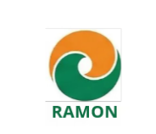

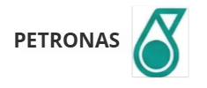

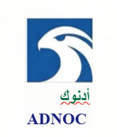






Apeiron
Selected Clientele
Shell​
sembcorp

Slide 18
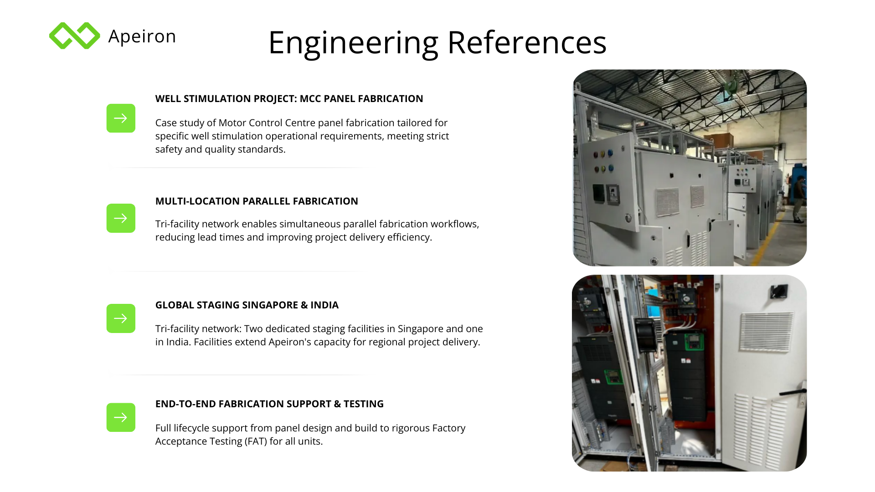

Slide 19
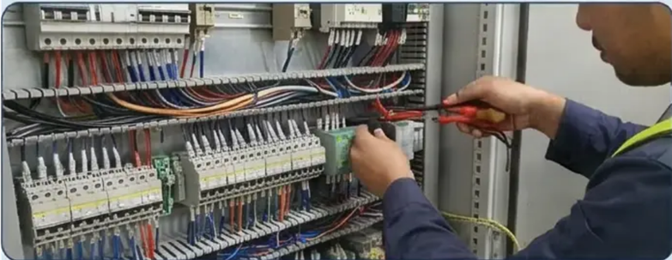
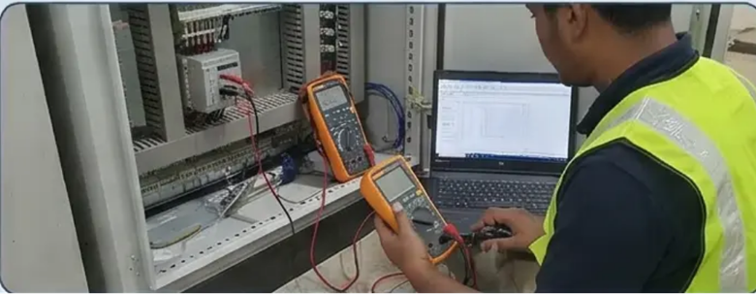
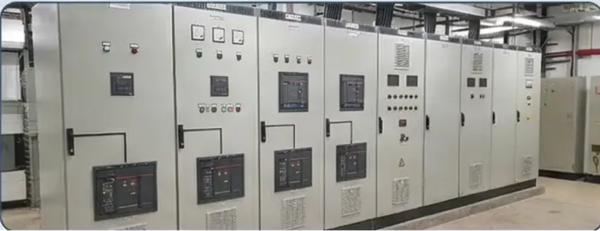
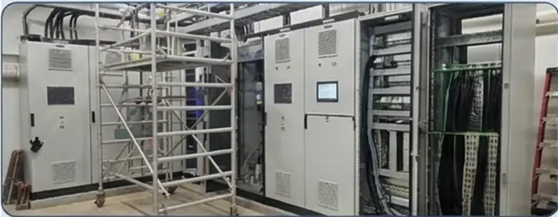
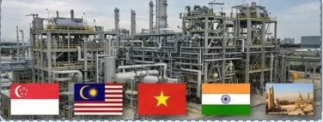
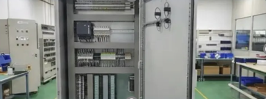
Apeiron
Site Installation References
ON-SITE SYSTEM INTEGRATION​
FIELD COMMISSIONING ACTIVITIES​
PANEL INSTALLATION PROJECTS​
Hands-on installation of control and safety​
systems across industrial facilities worldwide.​
Execution of SAT, loop checks, and system​
validation during live site commissioning​ phases.​
Deployment of MCC, ESD, and​
instrumentation panels in marine, offshore,​
and onshore environments.​
LARGE-SCALE RETROFIT WORKS​
MULTINATIONAL SITE PRESENCE​
STAGING AND PRE-ASSEMBLY SUPPORT​
Modernization of legacy systems; upgrade​
of multiple control panels on active sites.​
Installation references spanning Singapore,​
Malaysia, Vietnam, India, and the Middle East.​
Pre-installation staging conducted at Apeiron​
facilities in Singapore and India before site​
deployment.​

Slide 20
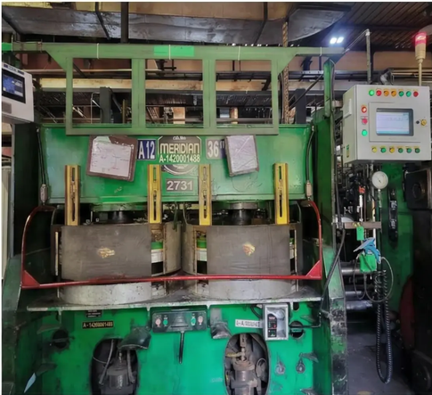
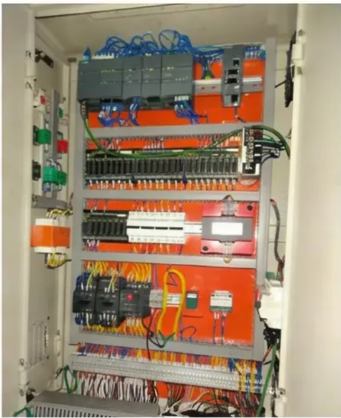
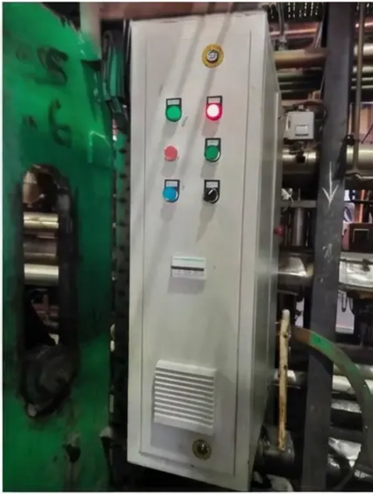
Apeiron
Project: Retrofit of 70 Curing Control Panels
Detail: Large-scale modernization of 70​ existing curing control panels across a single​ site installation.
Scope: Full Panel Upgrade & Replacement​
Site Installation References
Detail: End-to-end retrofit covering hardware​ replacement, rewiring, and control logic​ migration.
Capability: Large-Scale System Integration​
Detail: Demonstrates Apeiron's ability to​ manage high-volume, complex panel retrofit​ projects on-site.​
Retrofit 70 Curing Control Panel​
Execution: Site Commissioning Support​
Detail: On-site engineering team provided​ installation, testing, and commissioning for all​ 70 panels.​
Outcome: Modernized Control Infrastructure​
Detail: Upgraded panels deliver improved​ reliability, safety compliance, and operational​ performance.​

Slide 21
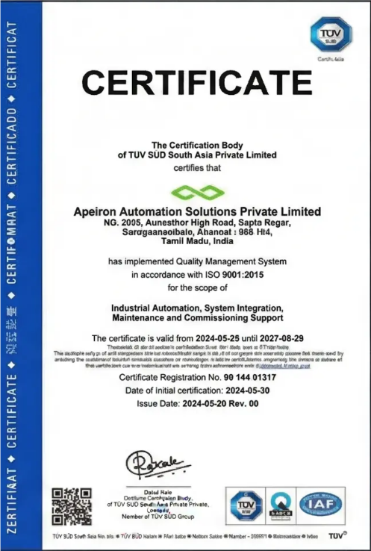
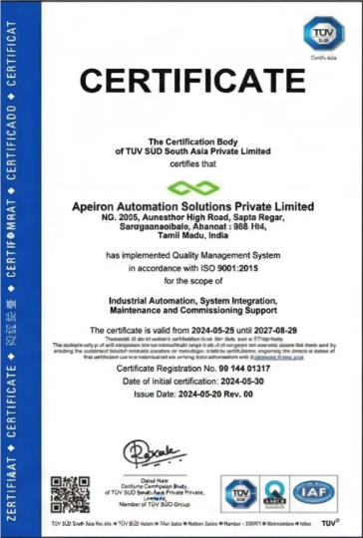
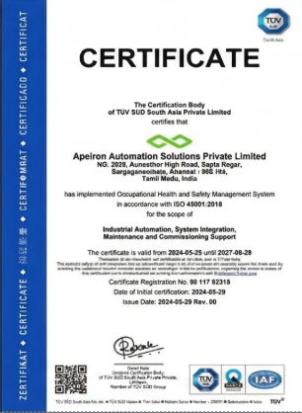
Apeiron
Certification: ISO 9001 &
ISO 45001
ISO 9001:2015 Certificate​
ISO 45001:2018 Certificate​

Slide 22
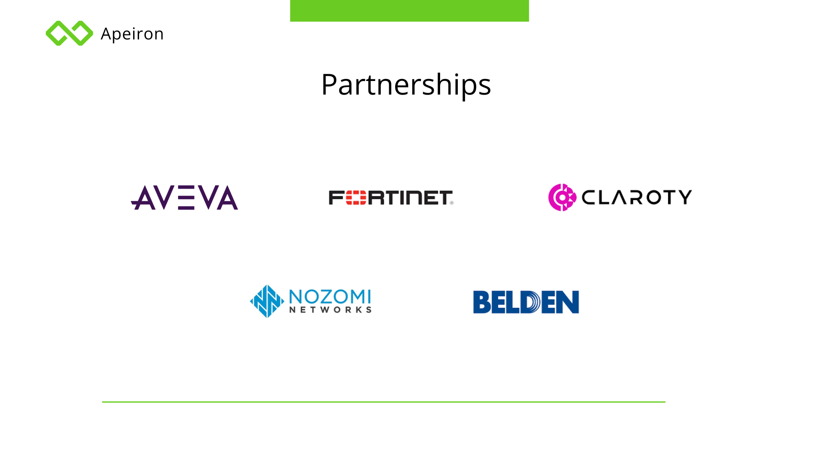

Slide 23
